Slide 1

Presentation
Team TLC

Slide 2
Challenge Title
Addressing Issue of Compromised IoT Devices

Slide 3
Background
Malware
Networked Devices running Linux into Remotely Controlled “bots”
Large-Scale DDOS Attack
Secure IoT
DDOS: Distributed Denial of Service

Slide 4
Background
Hacker
Launch an Attack

Slide 5
Background
Hacker
Launch an Attack

Slide 6
Background
Hacker
Launch an Attack

Slide 7
Background
Compromised
Compromised
Hacker
Launch an Attack
Compromised

Slide 8
Background
Compromised
Compromised
Hacker
Launch an Attack
Compromised

Slide 9
Background
DDOS Victim
Compromised
Compromised
Hacker
Launch an Attack
Compromised

Slide 10
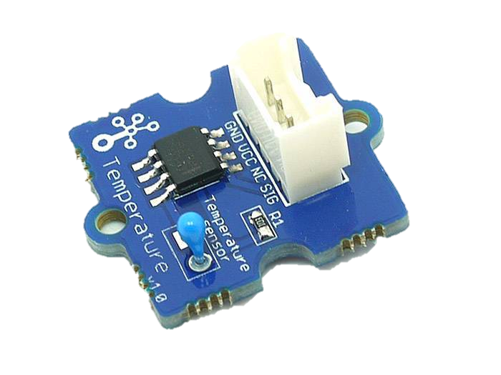
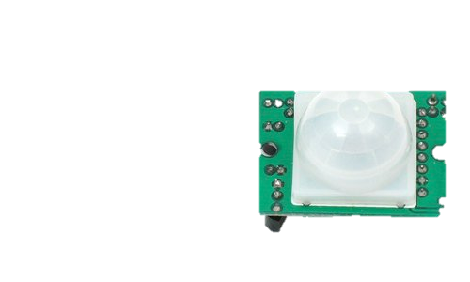

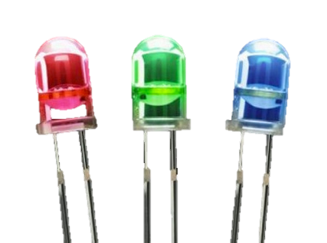

v
Smart Home
IoT devices at home
Motion
Temper-ature
ARM-ing
Camera
Facial Recognition
Light

Slide 11


Overview
Main Solution
Ease of Adoption
Prevent Attack
Whitelist of trusted IP address
Block unknown IP address
Detect Abnormal Behavior
Invalid Destination IP Address
Port Number
Unusual High Volume of Transmission
IoT Security

Slide 12


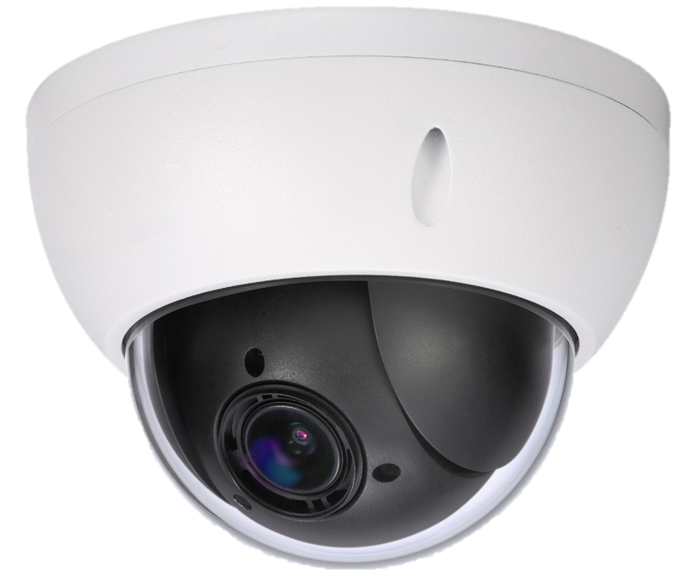
Network Diagram
LAPTOP
GROVE PI
IoT Hub
Temperature
Motion
RPI CAMERA
INTERNET
Face Recognition
HOME ROUTER
IOT GATEWAY
GUARDIAN
IP CAMERA
MOBILE PHONE

Slide 13
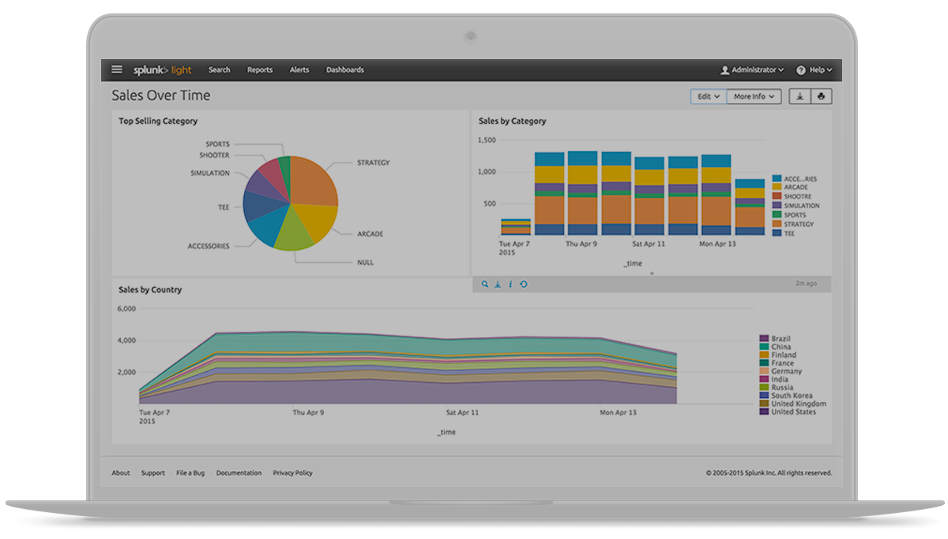




Detect Anomaly
Send Log File
IoT Gateway Guardian
Notify
IoT Gateway Guardian
Detect Anomaly
Trigger
Preventive Measures
Security Log Analyzer
ALERT
Data
Notify User
Port Number
IP Address

Slide 14
Wireshark
Network Analyzer Tool
Packets /sec over Time(s)
Packet flow of normal web traffic

Slide 15


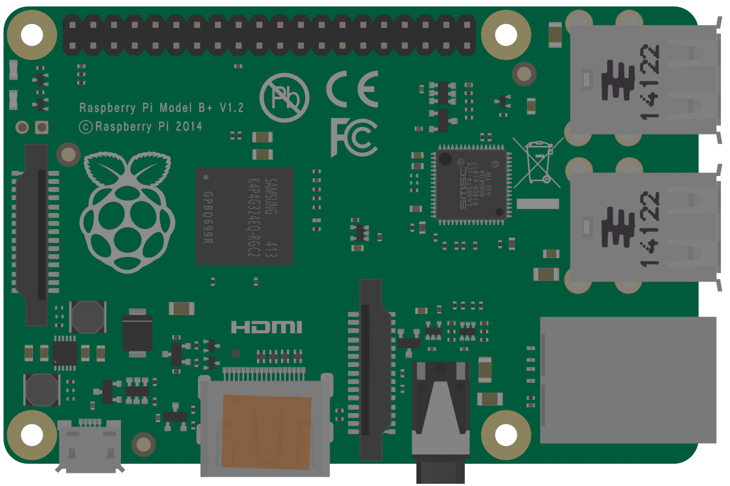


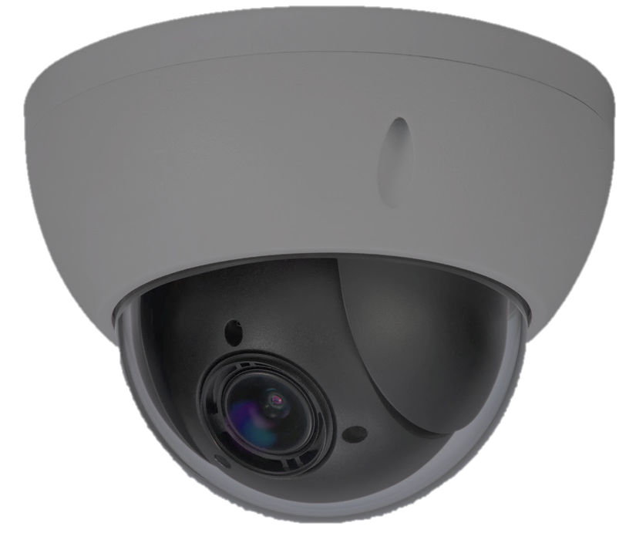
Demo Diagram
LAPTOP
MOBILE PHONE
GROVE PI
IoT Hub
Temperature
Motion
**Compromised**
RPI CAMERA
INTERNET
Face Recognition
HOME ROUTER
IOT GATEWAY
GUARDIAN
IP CAMERA
TARGET VICTIM

Slide 16


Demonstration

Slide 17
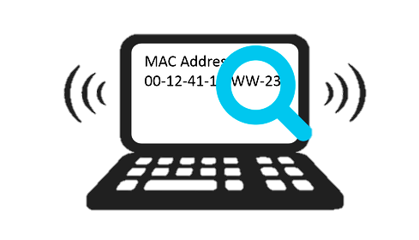
Security By Design
Detect Anomaly in Network Traffic
Whitelist of Access-List with default deny
Mac Address Authentication while Accessing Web Service
NAT to Prevent External Access to Internal Network Layer
NAT: Network Address Translation

Slide 18
THANK
YOU

Slide 20


Additional Features
If there is more time…
1
User able to understand
IP Address
Domain Name
216.58.221.78
www.google.com
2
Prevent infected IoT devices from infecting others
3
Detect malicious traffic targeting to compromise
IoT devices

